Slide 1
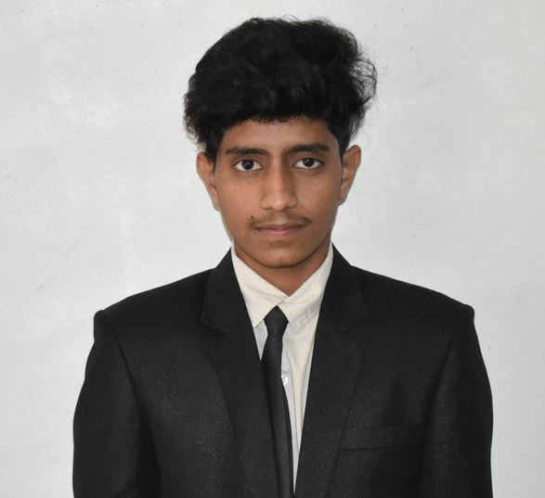


Mallipudi Satyanarayana Vamsi
Education and certificates
Bachelor of Engineering : 2018 - 2022
Analyst/Software Engineer
Base Location: Bangalore
Email ID: mallipudi-satyanarayana.vamsi@capgemini.com
^{Mobile No:} 8968885234
Skills
Core Java 11 Spring Core Spring Boot Spring MVC Spring REST Spring Security React Js
Spring Cloud Microservices
Database
No SQL database – MongoDB
Web Technologies
HTML5 CSS3
Javascript
AddOns Github Maven RabitMQ
Additional Details
Leadership
Good Communication Skills
Team management
Grade:
A4
Strengths
Software Engineer who is Strong in design and integration with intuitive problem-solving skills Passionate about implementing and launching new projects
Ready to learn new technologies and implement them to further improve my knowledge.
Hands on experience in implementing Microservice architecture and spring boot
Has intermediate level knowledge on Java, microservices architecture using spring frameworks and ReactJS.
Worked on Spring boot Application, JWT authentication, spring API, Swagger UI and Eureka Server.
Achivement
OnDemand Car Wash System web application
Developed a web application which solves long term problem of time-consuming physical car washing system. Using this application anyone can book a wash for their cars at any time and at any location. Used MongoDB as database, microservice architecture for agility and ReactJS for responsive website.

